Slide 1
Development of the Extended Strengths and Weaknesses Assessment of Normal Behavior (E-SWAN)
Lindsay Alexander, MPH
Clinical Data Manager
CMI Healthy Brain Network

Slide 2
Disclosures
No conflicts of interest to disclose

Slide 3
Overview
Background & Project Rationale
E-SWAN Development Process
Example E-SWAN Questions
Results of Item Response Theory Analysis
Conclusions

Slide 4
Background
Myriad questionnaires have emerged for measuring psychiatric illness dimensionally.
However, the vast majority are based upon the presence or absence of problematic behaviors and symptoms.
  This focus limits the ability to distinguish individuals because they focus at 'one end' of the distribution (i.e., the pathological trait range).
  Problematic for epidemiologic and neurobiological (e.g., genetics, imaging) research studies attempting to model behaviors across a broad population.

Slide 5
Background
Typical rating scales use 0 to 3 ratings of symptoms that define abnormal behavior (weaknesses):
  0=Not at all
  1=Occasionally
  2=Often
  3=All the time

Slide 6
Background
In a non-clinical population, a high percentage of scores will be centered between 0 and 1, generating a truncated distribution.
  Leads to reduced variance
  Statistical cutoffs based on truncated scores may over- or under-identify extreme cases in the truncated distribution
Normal
Truncated

Slide 7
Strengths and Weakness of ADHD Symptoms and Normal Behavior (SWAN)
Re-worded items as strengths rather than weaknesses
  DSM Criteria: Often fails to give close attention to details or makes careless mistakes in schoolwork, at work, or during other activities
  SWAN Item: Gives close attention to detail and avoids careless mistakes
Expanded the 4-point scale of symptom presence to a 7-point scale
  3=Far Below Average
  2=Below Average
  1=Slightly Below Average
  0=Average
  -1=Slightly Above Average
  -2=Above Average
  -3=Far Above Average
(Swanson et al, 2000 and Swanson et al., 2012)

Slide 8
Strengths of the SWAN
Many published studies show the value of capturing variance associated with both strengths and weaknesses to generate a near-normal distribution of ratings in epidemiological samples.
  SWAN has comparable validity and reliability to other ADHD scales
  SWAN is preferred measure for measuring positive attention and impulse regulation behaviors
  Measures more variance at the adaptive end of ADHD symptoms
  Skewness and kurtosis statistics for the SWAN were within the range expected for a normal distribution
  (Arnett, 2011; Hay et al, 2007; Lakes, 2012; Polderman et al, 2007; Swanson, 2012)

Slide 9
A Neuroimaging Case Example
Capturing the Neural Correlates of Trait Differences in Attentional Regulation: The Impact of Questionnaire Design (Poster Session 2; # 2.37)
  Data from 104 participants (ages 6-17) collected as part of the Nathan Kline Institute-Rockland Sample

Slide 10
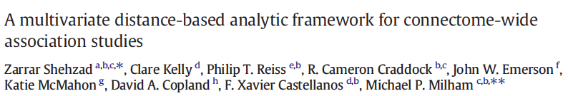
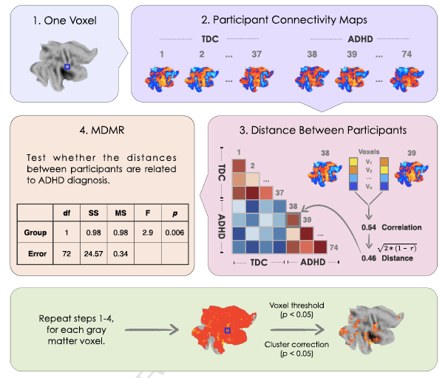

Slide 11
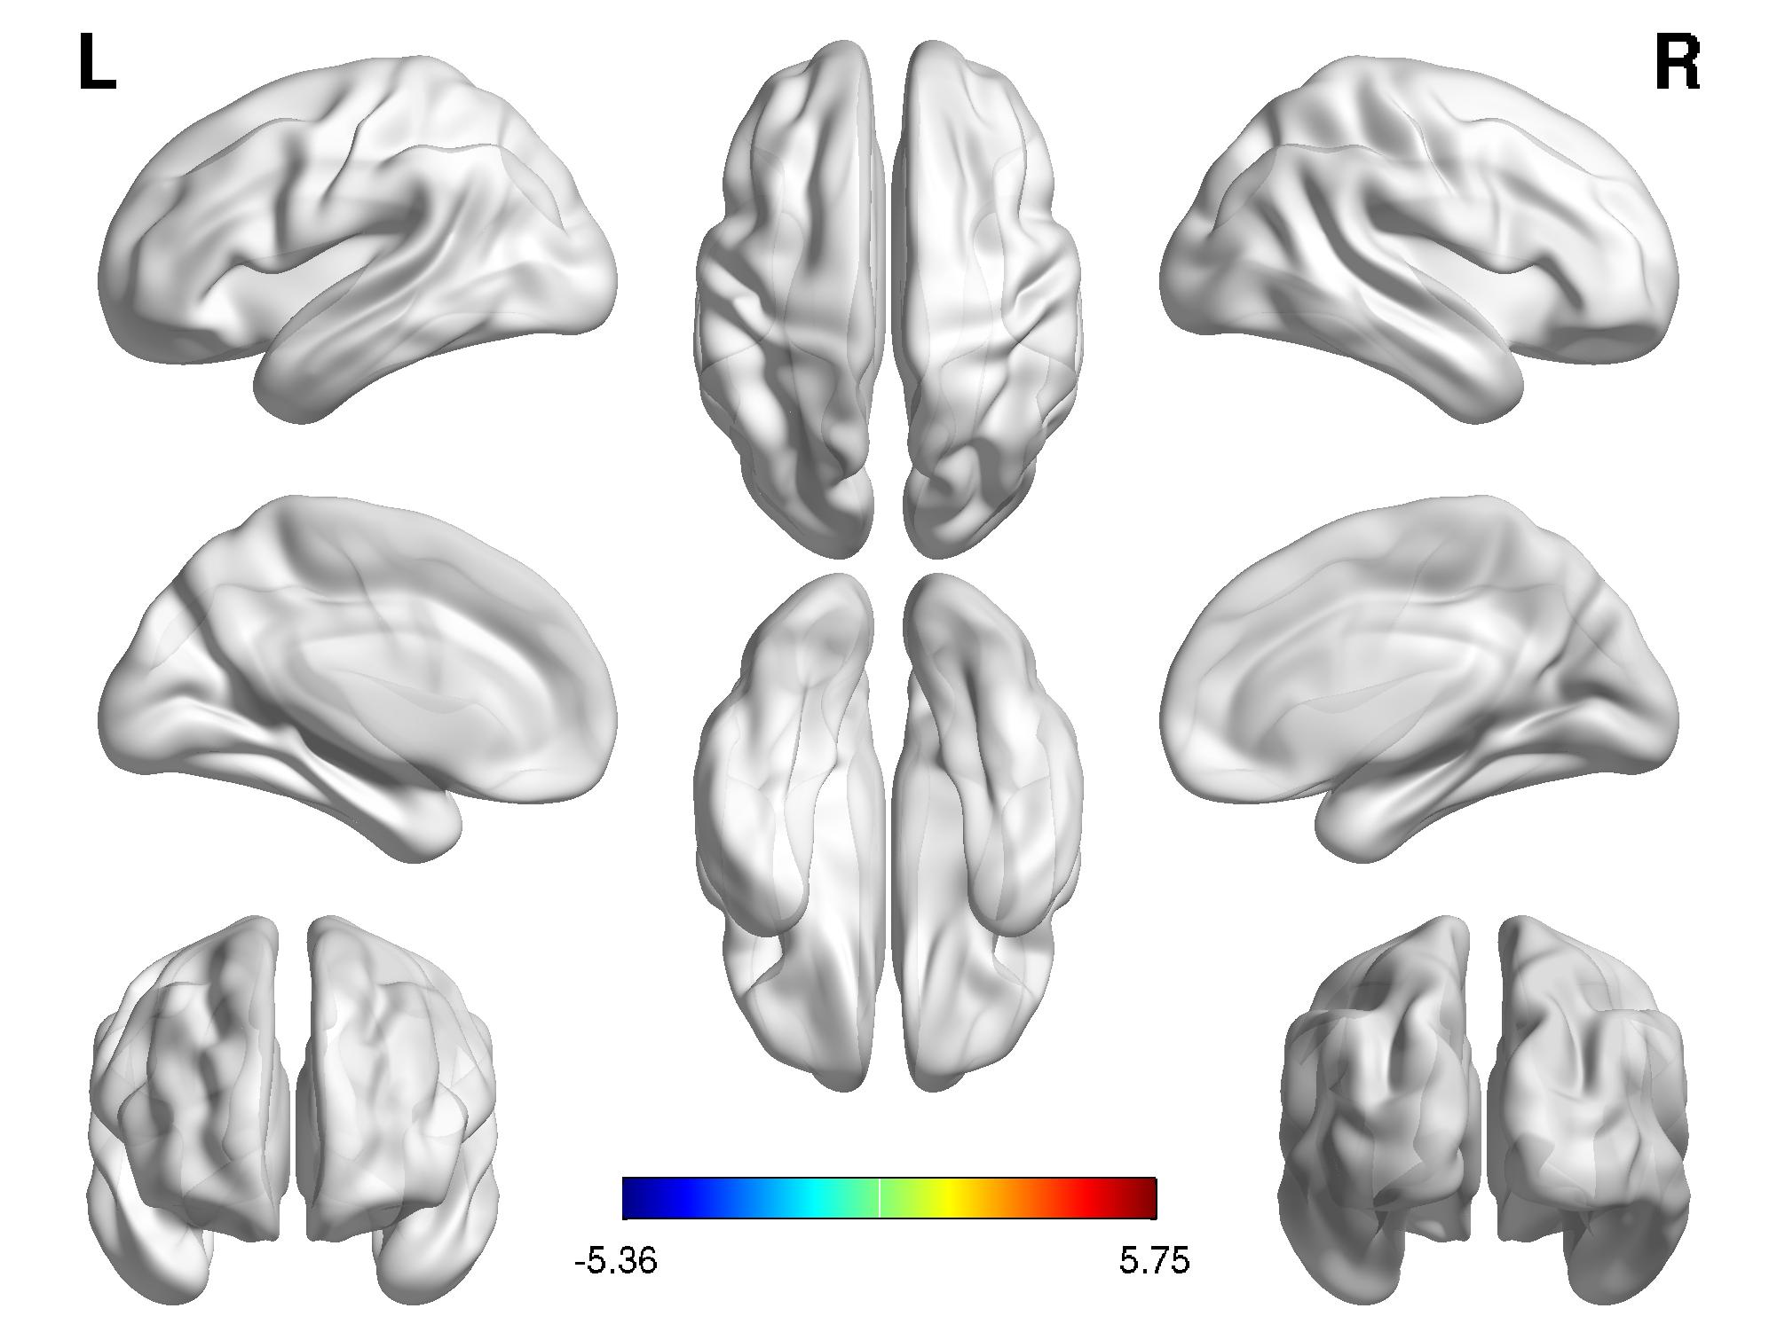
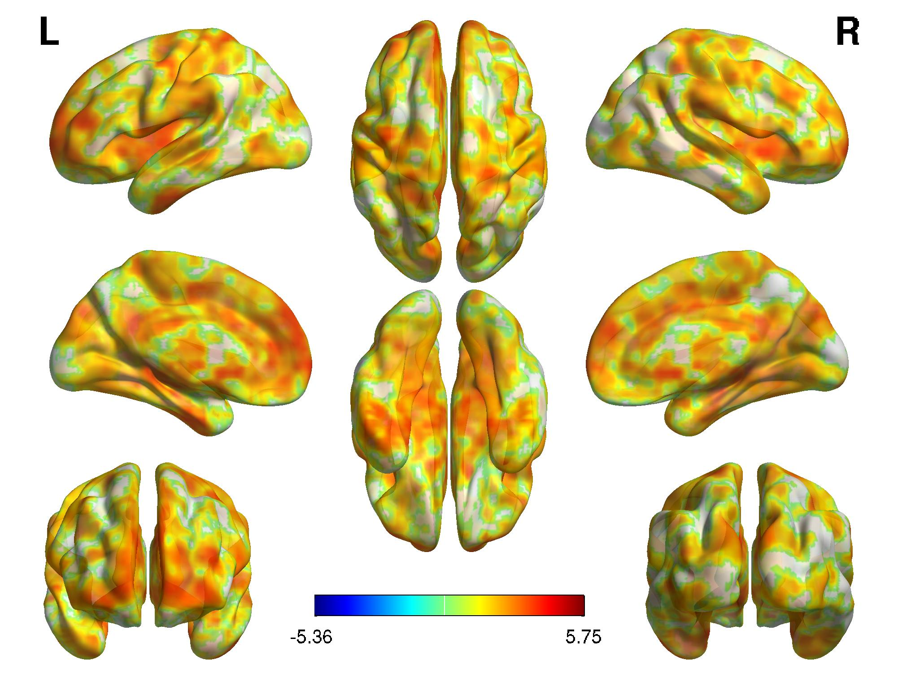
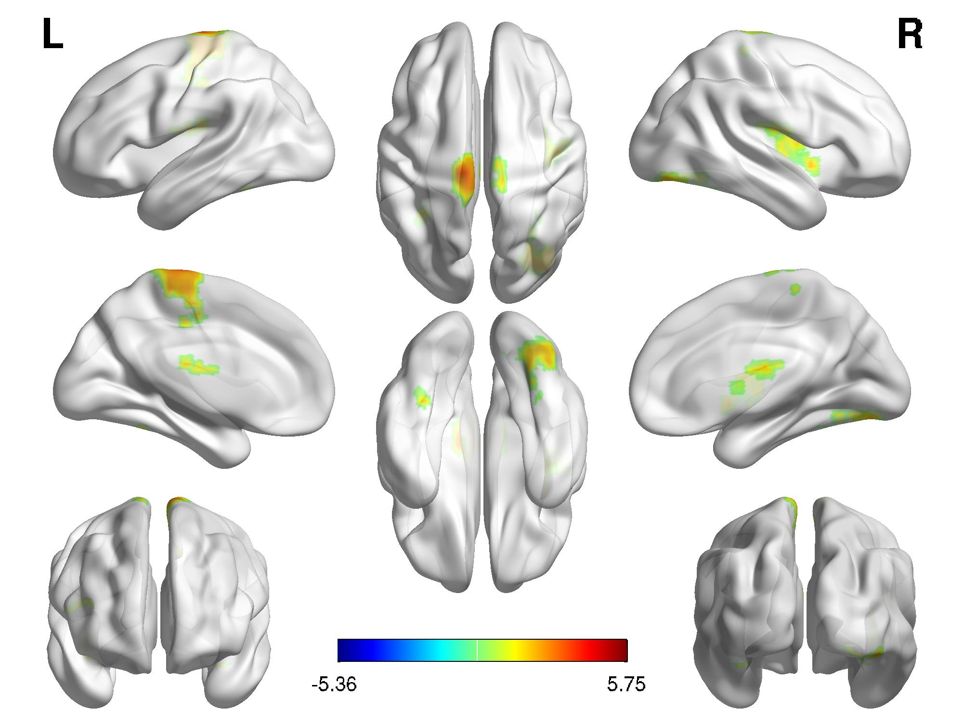
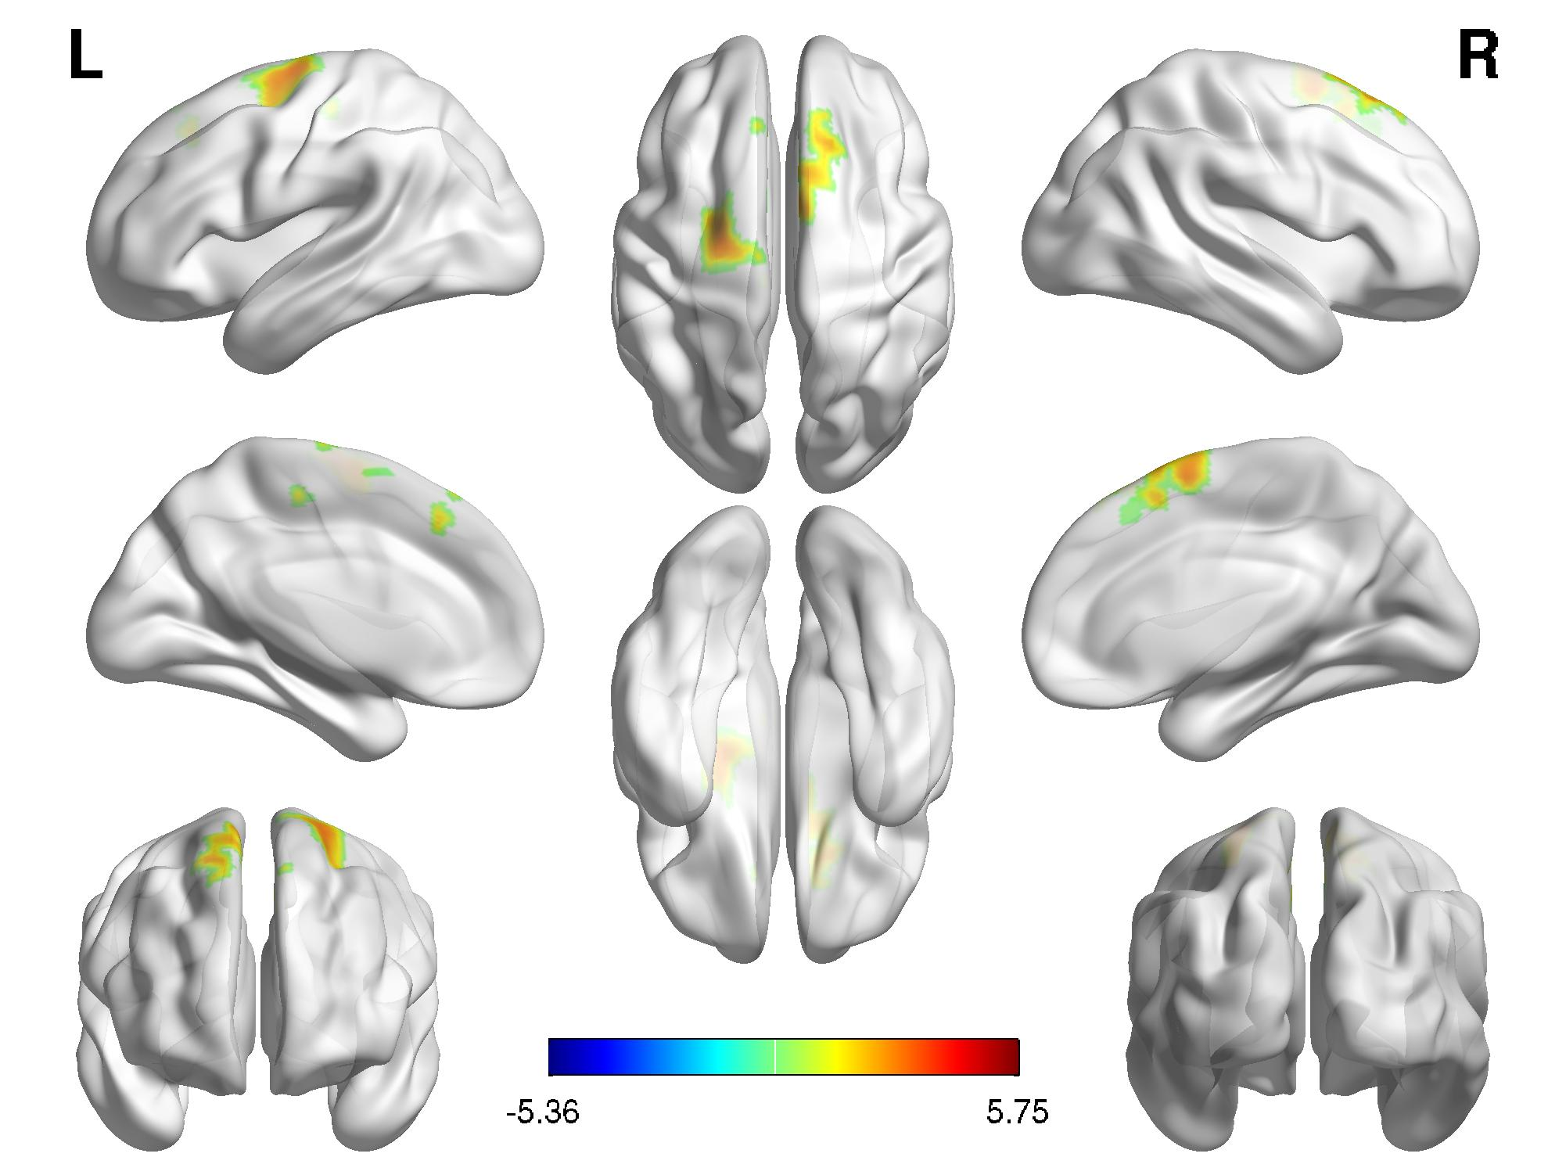
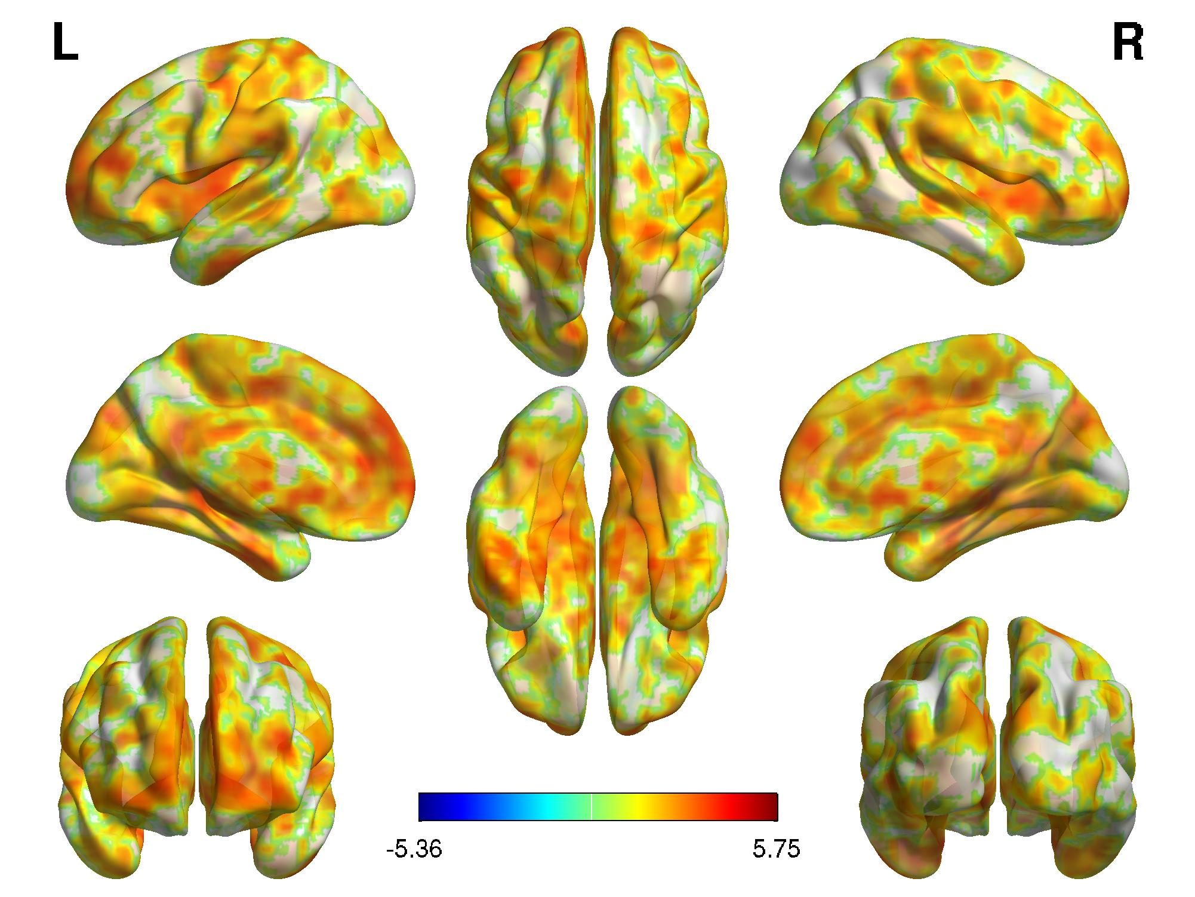
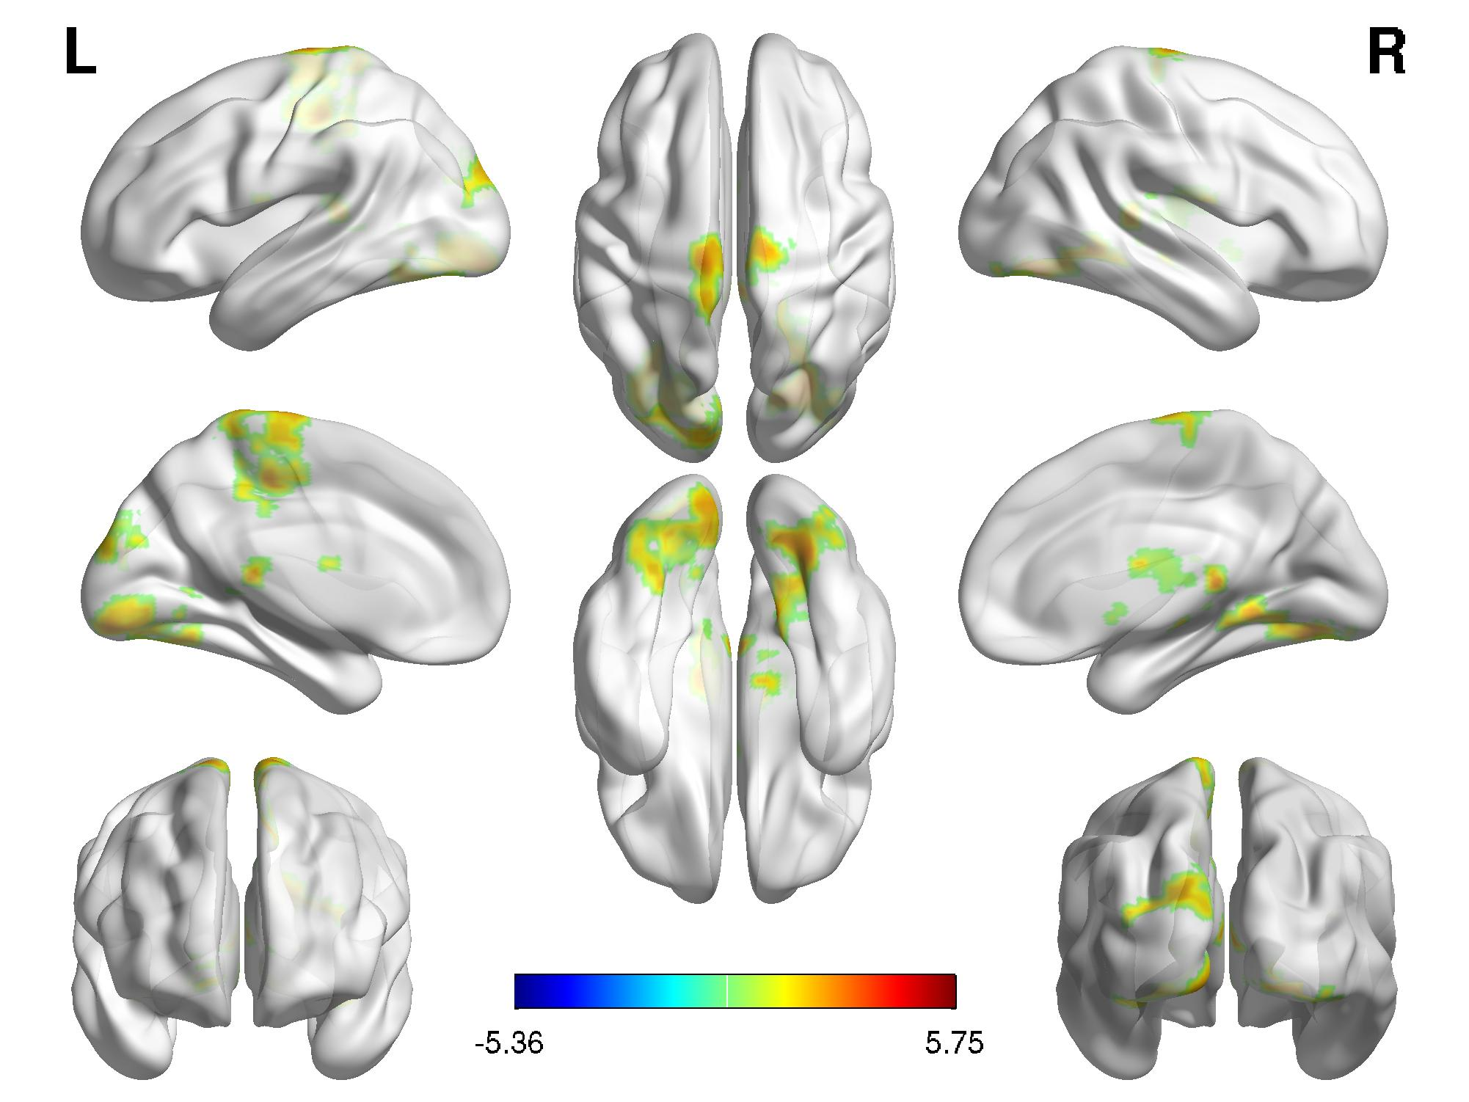
Results and Conclusions
Inattention
Age
Inattention * Age
Hyperactivity
Age
Hyperactivity * Age
* Only results for the SWAN passed statistical correction

Slide 12
Results and Conclusions
SWAN
SWAN
Conners
Conners
BASC
BASC
CBCL
CBCL
Density
Density
Pseudo F Value
Pseudo F Value
MDMR analyses yielded similar patterns of voxel-wise results for the differing questionnaires, though the findings with the SWAN were more robust; as a result, only results for the SWAN passed statistical threshold.

Slide 13
Extended Strengths and Weaknesses Assessment of Normal Behavior (E-SWAN)
The E-SWAN is a collaborative effort focused on the extension of the SWAN framework to the broader range of DSM 5 disorders
  Giovanni Salum, Michael Milham, James Swanson
Here we report on the initial design and feasibility testing of the E-SWAN questionnaire set
Initial questionnaires focused on DSM 5 Disorders:
  Major Depressive Disorder & Social Anxiety
    High prevalence disorders
  Panic Disorder
    Challenge of dimensionalizing physiological symptoms
  Disruptive Mood Dysregulation Disorder (DMDD)
    New to DSM 5, few valid measures available

Slide 14
Process
Each questionnaire was developed using a three step process:
  Each DSM-5 criterion was broken-down to reflect specific symptoms, which are core to each of the DSM-5 disorders.
  Each specific symptoms was transformed into its underlying ability, i.e., the ability that when impaired gives rise to the symptom.
  Each item was worded to be answered in a 7-point scale representing deviation from children from the same age, following the statement: “When compared to children of the same age, how well does this child”.

Slide 15
Step 1: Operationalizing symptoms for each DSM-5 disorder
Challenges
  DSM-5 criteria vary in the level of detail and nuance
    Multiple phrases vs. single
  Some criteria can be relatively complex in structure, relying on more than a simple checklist of symptoms
  Some disorders require assessment of behaviors in more than one context

Slide 16
Step 1: Operationalizing symptoms for each DSM-5 disorder
Example: Social Anxiety
One DSM Criterion:
The social situations almost always provoke anxiety
One Symptom:
Anxiety in social situations
=
Example: DMDD
One DSM Criterion:
Severe recurrent temper outbursts manifested verbally and/or behaviorally that are grossly out of proportion in intensity or duration to the situation or provocation
At least 5 symptoms, or symptom characteristics:
Verbal outbursts
Behavioral outbursts
Intensity
Duration
Situational
=

Slide 17
Step 2: Transforming Symptoms into Underlying Abilities
Item content was generated with the following guidelines:
  Items should reflect the underlying abilities for each criterion
  Items should not contain age restriction criteria or developmentally inappropriate behaviors
Standardized item formats were used for each type of symptom
  Example: Frequency & Duration items- “is able to avoid (no occurrence) or limit (reduce frequency or duration) behaviors, emotions or thoughts”
Example: Social Anxiety
DSM Criterion:
Marked fear or anxiety about one or more social situations in which the individual is exposed to possible scrutiny by others
E-SWAN:
Overall Prompt:
Compared to other children of the same age, how well does this child:
Question:
Tolerate feelings of anxiety in social situations

Slide 18
Step 2: Transforming Symptoms into Underlying Abilities
Example: Panic Disorder
Part A. Assess experience of panic attacks
Compared to other children of the same age, most of the time, how well does this child:
Avoid or limit moments of intense fear or discomfort that occur ‘out of the blue’
Keep the mind free from worries about experiencing intense fear or discomfort
Return to typical behaviors/activities after experiencing a moment of intense fear or discomfort
DSM Symptoms:
Palpitations, pounding heart, or accelerated heart rate
Sweating
Trembling or shaking
Part B. Assess experience of panic attacks
Compared to other children of the same age, during moments of intense fear or discomfort, how well does this child:
Keep a regular heartbeat
Keep dry and cool
Keep hands steady

Slide 19
Step 3: Item Wording
Items were worded to be able to be answered on a 7 point scale
  Far above average to far below average
Overall guidelines for item construction were also followed, according to standardized practices according to three simple criteria established by the PROMIS guidelines:
  Clarity
  Precision
  General applicability
Example: Depression
DSM Criteria
E-SWAN
Show interest in performing activities
Markedly diminished interest or pleasure in all, or almost all activities most of the day, nearly every day
Enjoy activities
SWAN
Conners
BASC
CBCL
Density
Pseudo F Value

Slide 20
Step 3: Item Wording
Example: DMDD
Problem: Not precise because DSM criteria requires that these behaviors are present in more than one setting
Solution: Separate items assessing the same behavior across settings
Sample E-SWAN Questions:
Avoid or control arguing or yelling
Avoid or control getting into fights
Avoid or control arguing or yelling at home
Avoid or control arguing or yelling at school
Avoid or control arguing or yelling with friends
Avoid or control getting into fights at home
Avoid or control getting into fights at school
Avoid or control getting into fights with friends

Slide 21
Final E-SWAN Questionnaires
Circulated to experienced clinicians for feedback
Informal testing for language in local clinics in Brazil
Pilot testing underway at CMI Healthy Brain Network
  Clinically-referred sample design
  Focused on data collection in the NYC area
  Target sample size = 10,000 (current enrollment = 605)
  E-SWAN added in July, 2016 (n = 161)

Slide 22
Social Anxiety

Slide 23
Depression

Slide 24
Panic Disorder

Slide 25
DMDD

Slide 26
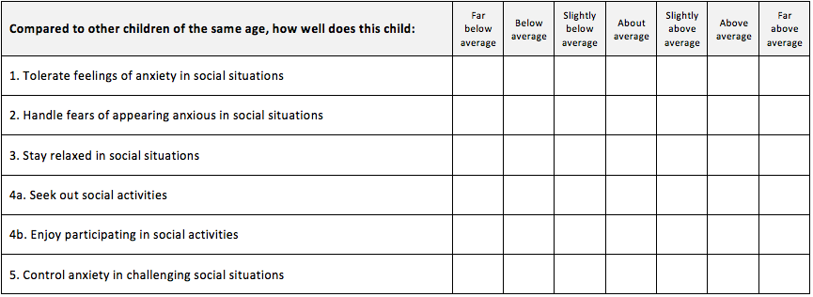
Sample E-SWAN With 7 Point Scoring

Slide 27
Preliminary Data Analysis

Slide 28
Sample Characteristics
Diagnosis data, as assessed by the KSADS, is currently available for 83 out of 161 participants
  Remainder pending completion of the Healthy Brain Network study

Slide 29
Average Score Distributions (N=161)
E-SWAN
DMDD
Social Anxiety
Panic Disorder
Depression
ADHD
Average Score
Average Score
Average Score
Average Score
Average Score
Traditional Scales
Affective Reactivity Index
SCARED Social Anxiety
SCARED Panic Disorder
Mood and Feelings Questionnaire
SDQ Hyperactivity
Score
Score
Score
Score
Score

Slide 30
Item Response Theory
Item Response Theory (IRT):
  Examines how specific test or questionnaire items function in measuring abilities, attitudes, or other variables
  Focus on individual items that make up a test or questionnaire, rather than an aggregate score of the items in a test
Graded Response Models (GRM):
  Used in IRT analysis for data that follows a Likert-type rating scale
Test Information Function:
  Shows the locations on the latent trait where test is capturing information across all test items
Item Information Curve:
  Shows the locations on the latent trait where test is capturing information for each individual test item

Slide 31
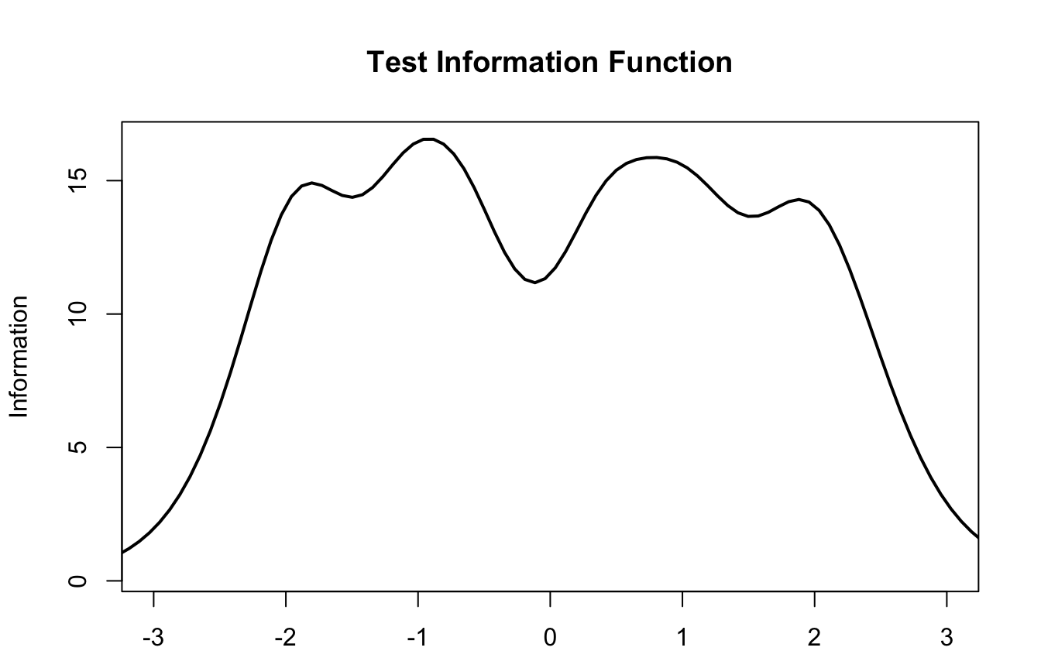
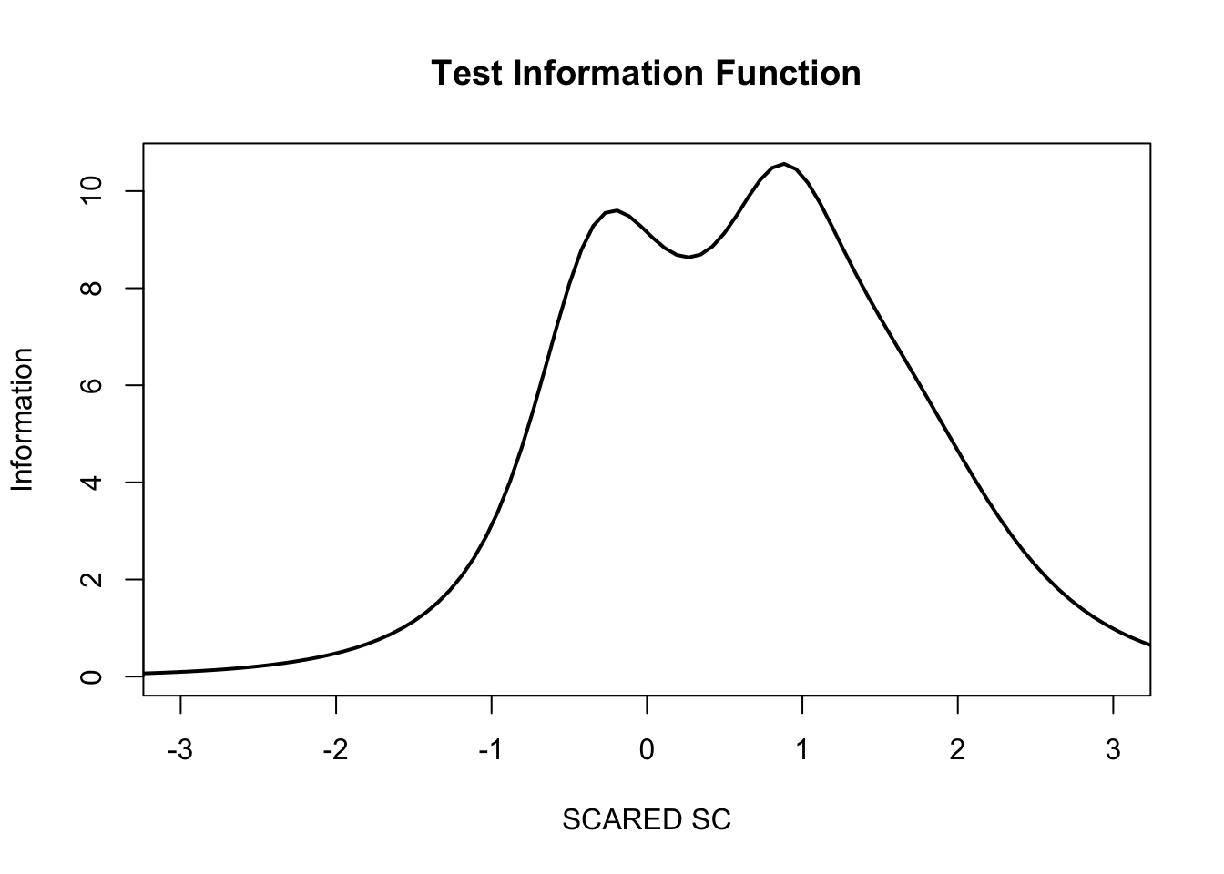
Comparison of Test Information Function
Latent Trait Measured by
E-SWAN Social Anxiety Subscale
Latent Trait Measured by
SCARED Social Anxiety Subscale

Slide 32
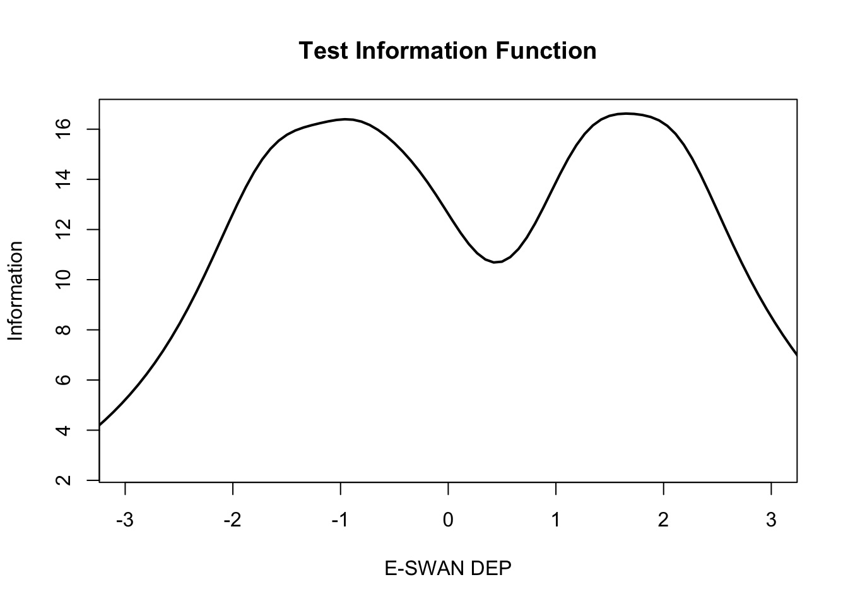
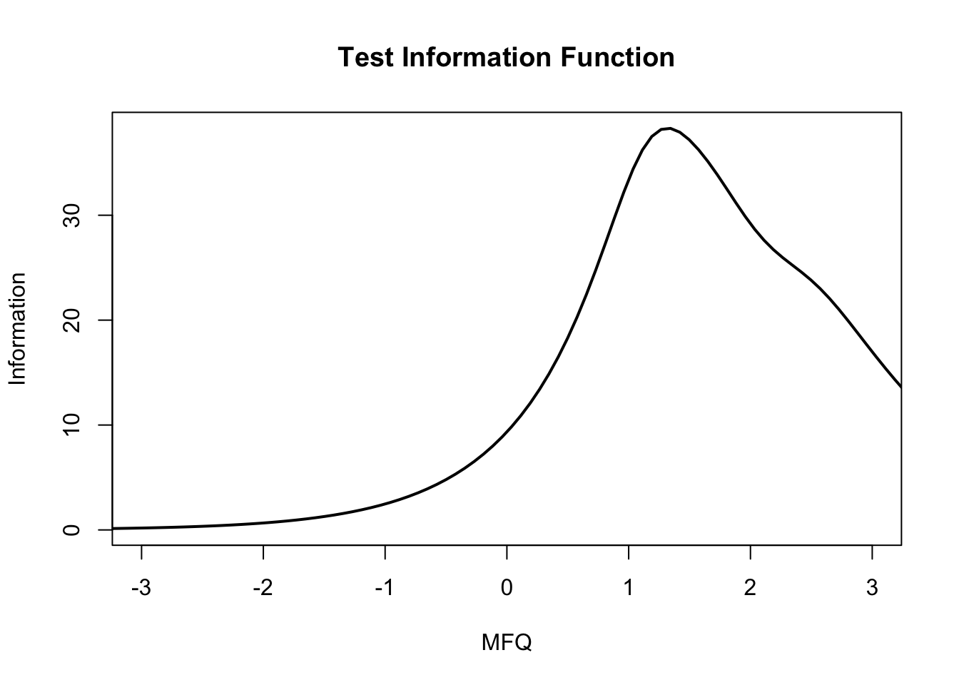
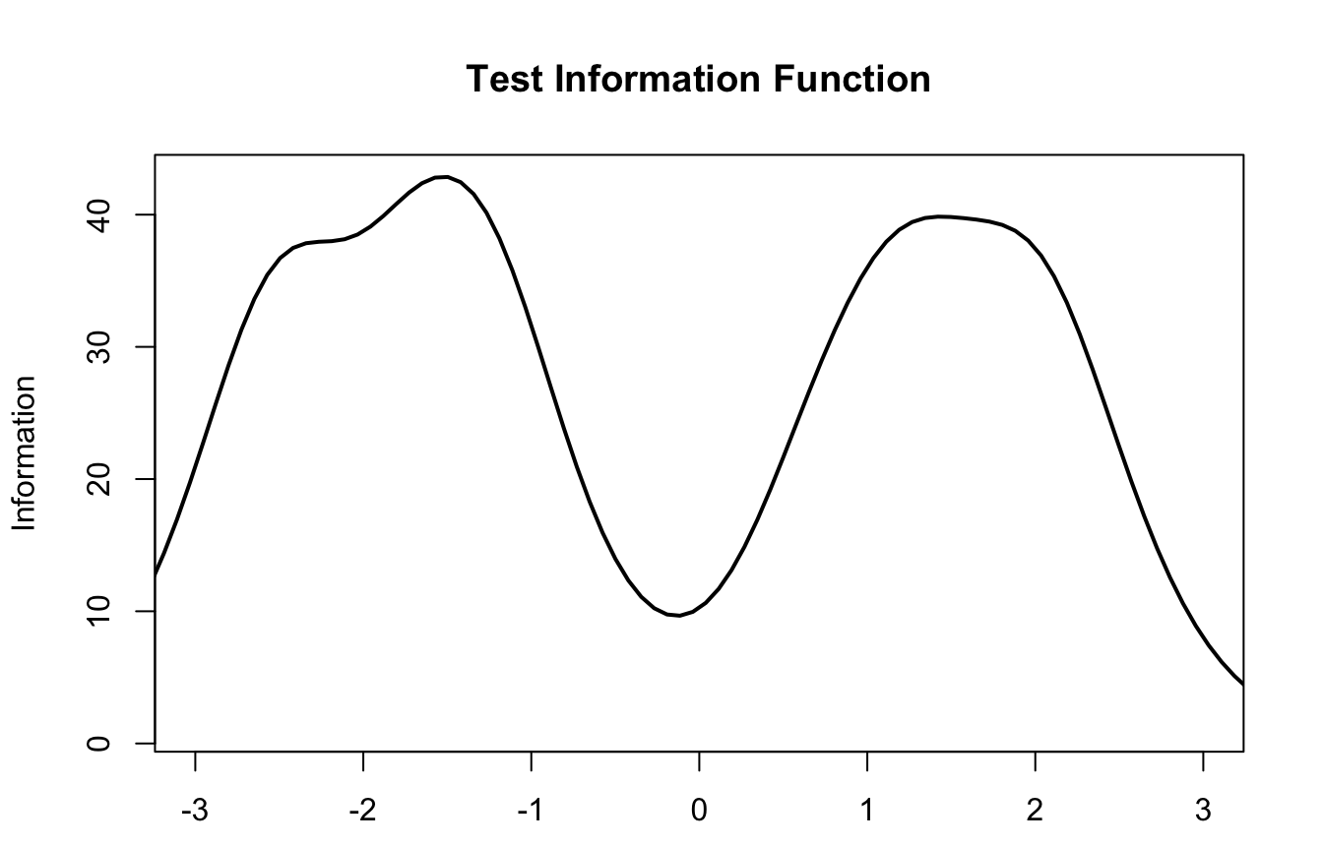
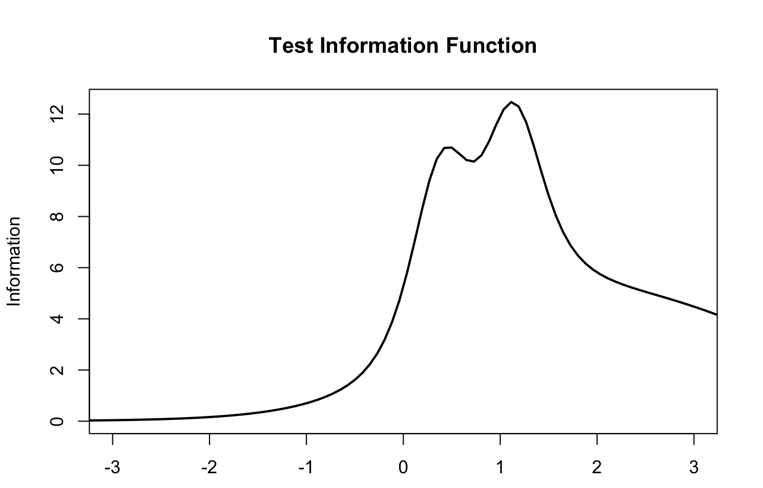
Comparison of Test Information Function
E-SWAN
Traditional Scales
Latent Trait Measured by
E-SWAN Depression Subscale
Latent Trait Measured by
Mood and Feelings Questionnaire (MFQ)
Latent Trait Measured by
E-SWAN Panic Disorder Subscale
Latent Trait Measured by
SCARED Panic Disorder Subscale

Slide 33
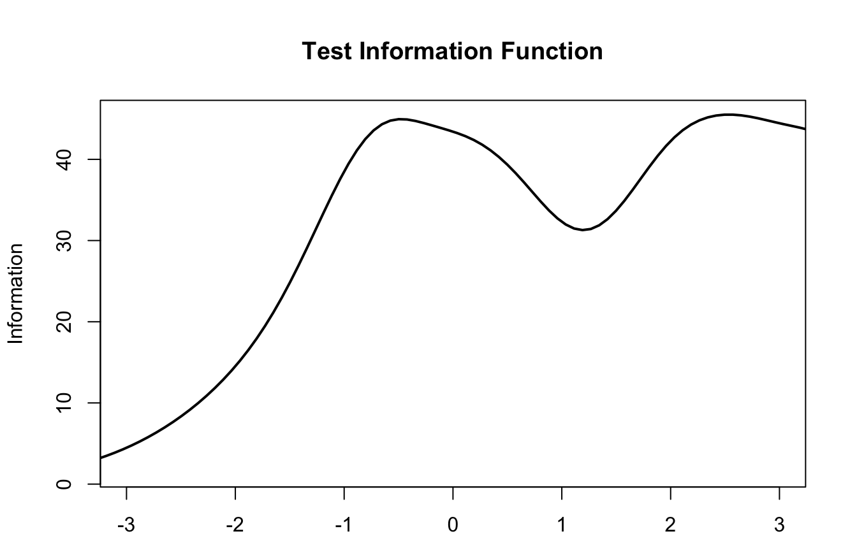
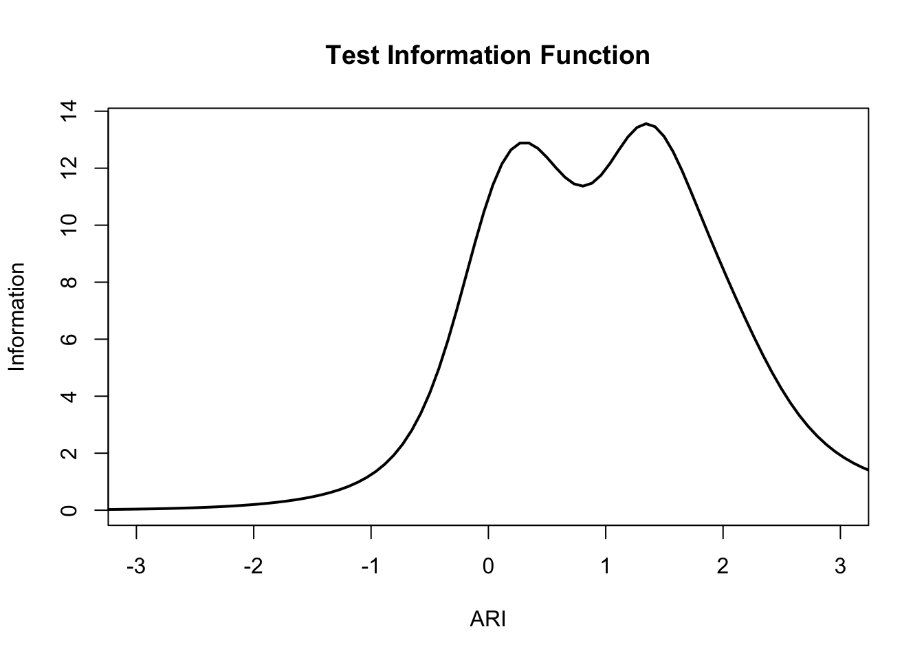
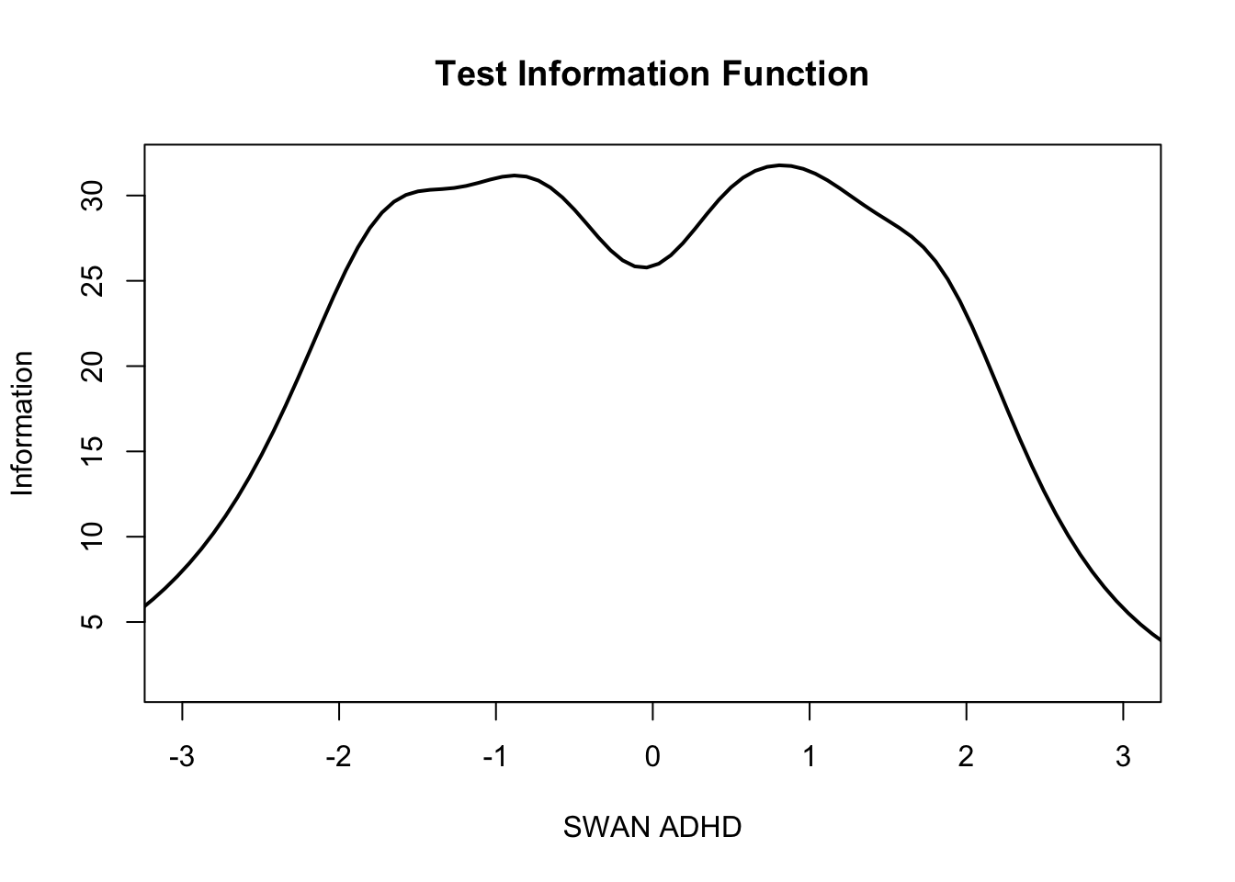
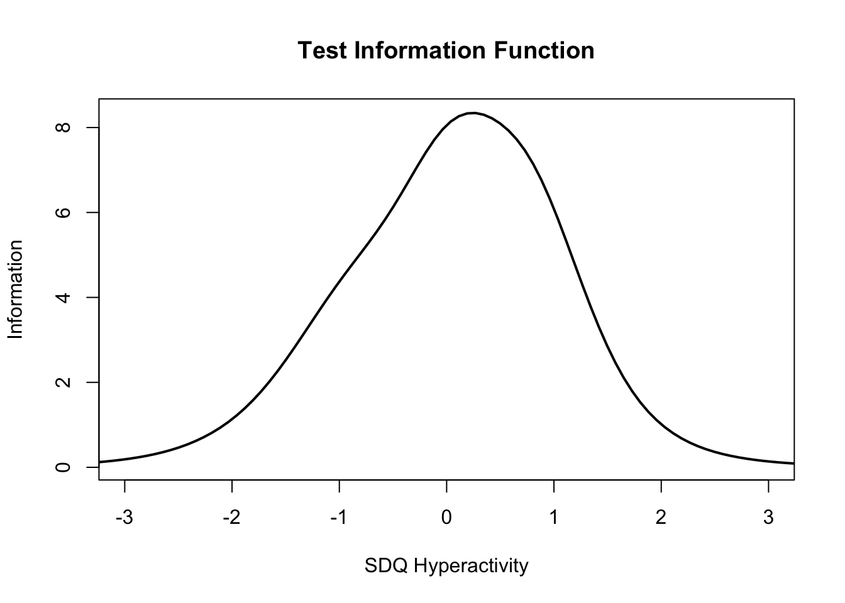
Comparison of Test Information Function
E-SWAN
Traditional Scales
Latent Trait Measured by
E-SWAN DMDD Subscale
Latent Trait Measured by
Affective Reactivity Index (ARI)
Latent Trait Measured by
E-SWAN ADHD Subscale
Latent Trait Measured by
SDQ Hyperactivity Subscale

Slide 34
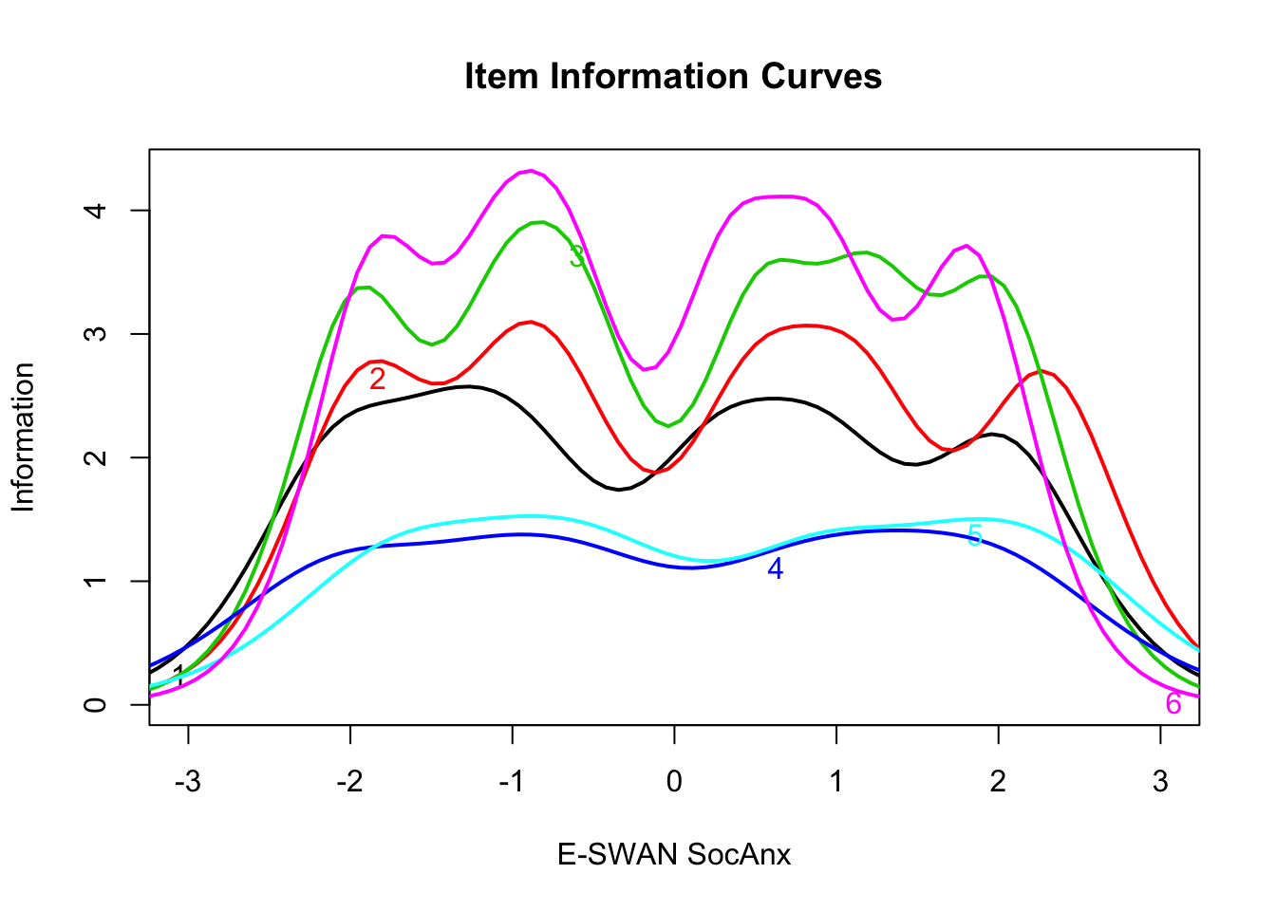
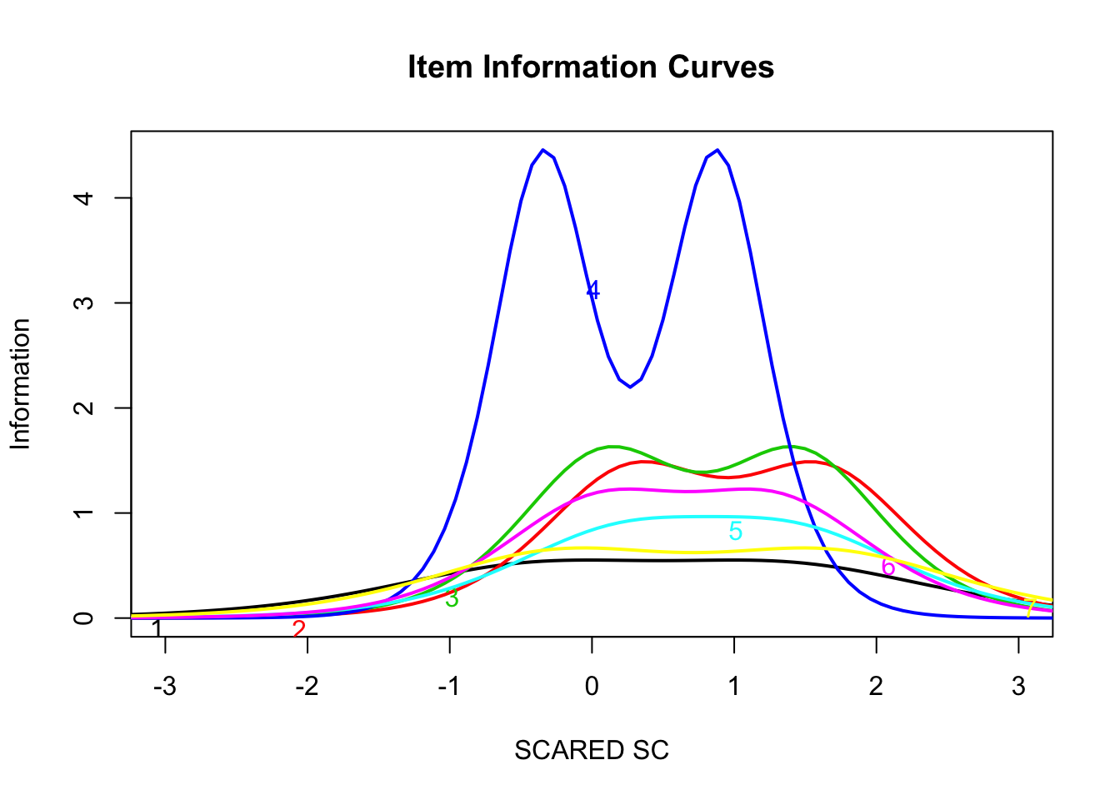
Comparison of Item Information Function
Latent Trait Measured by
E-SWAN Social Anxiety Subscale
Latent Trait Measured by
SCARED Social Anxiety Subscale

Slide 35
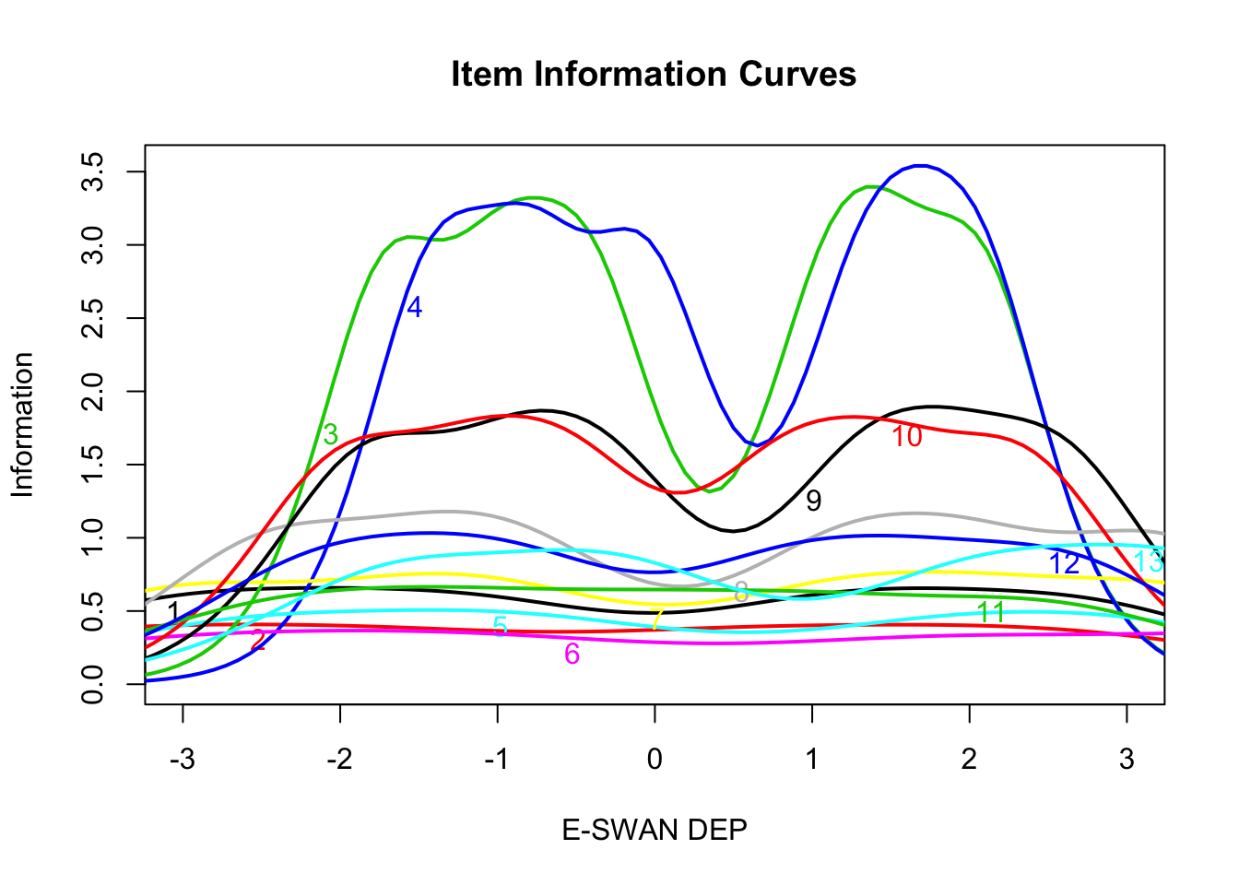
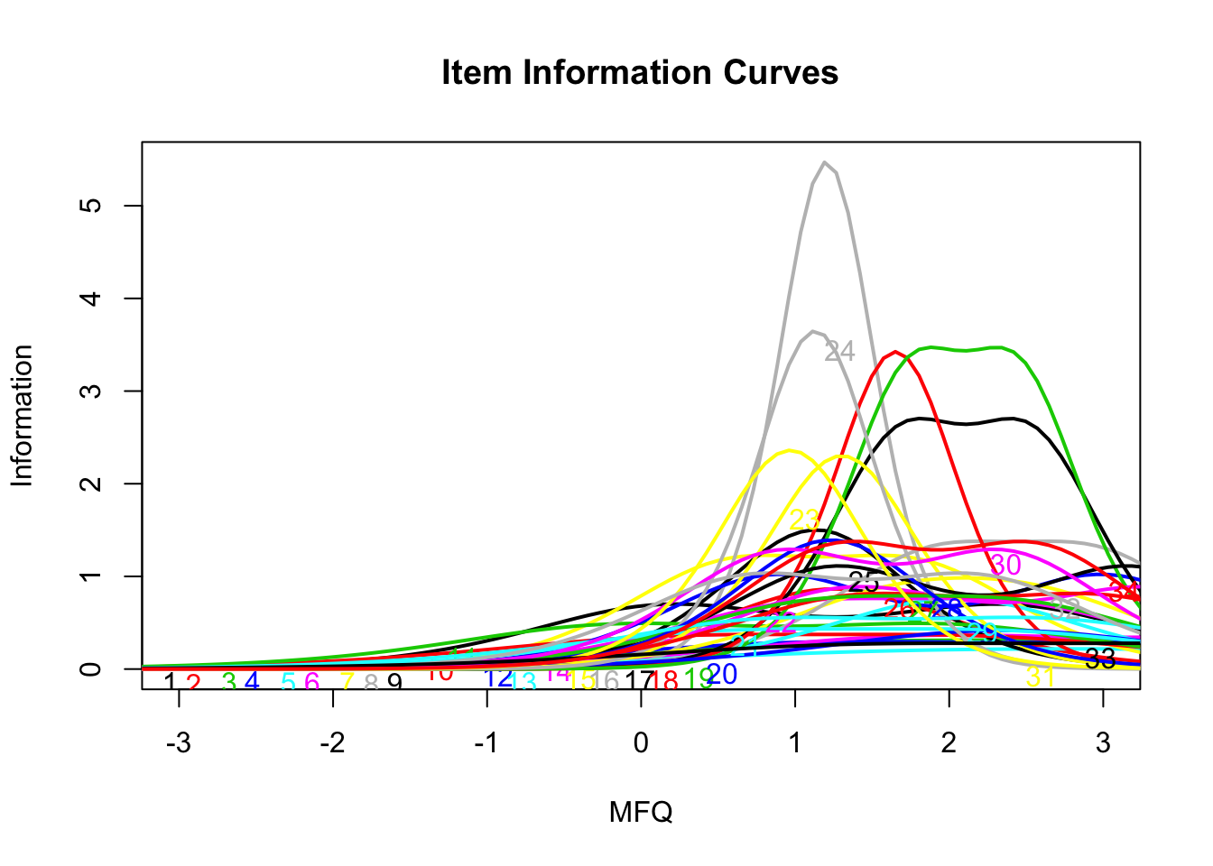
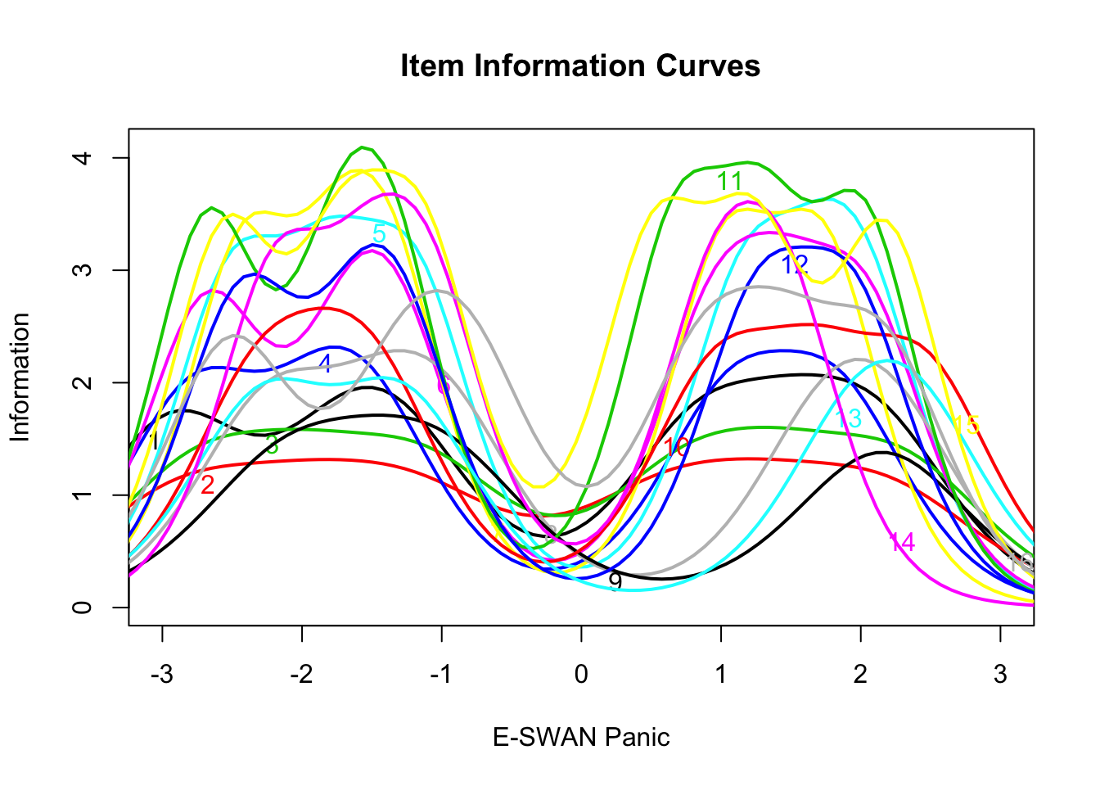
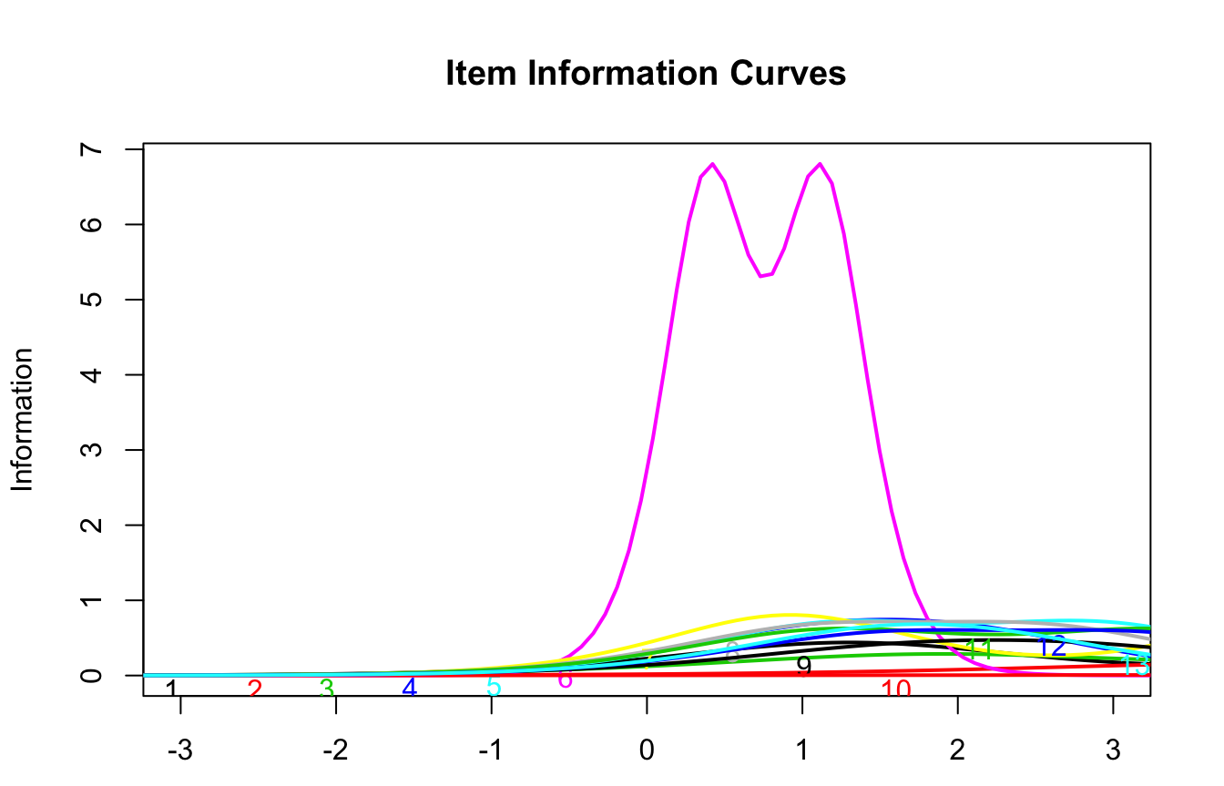
Comparison of Test Information Function
E-SWAN
Traditional Scales
Latent Trait Measured by
E-SWAN Depression Subscale
Latent Trait Measured by
Mood and Feelings Questionnaire (MFQ)
Latent Trait Measured by
E-SWAN Panic Disorder Subscale
Latent Trait Measured by
SCARED Panic Disorder Subscale

Slide 36
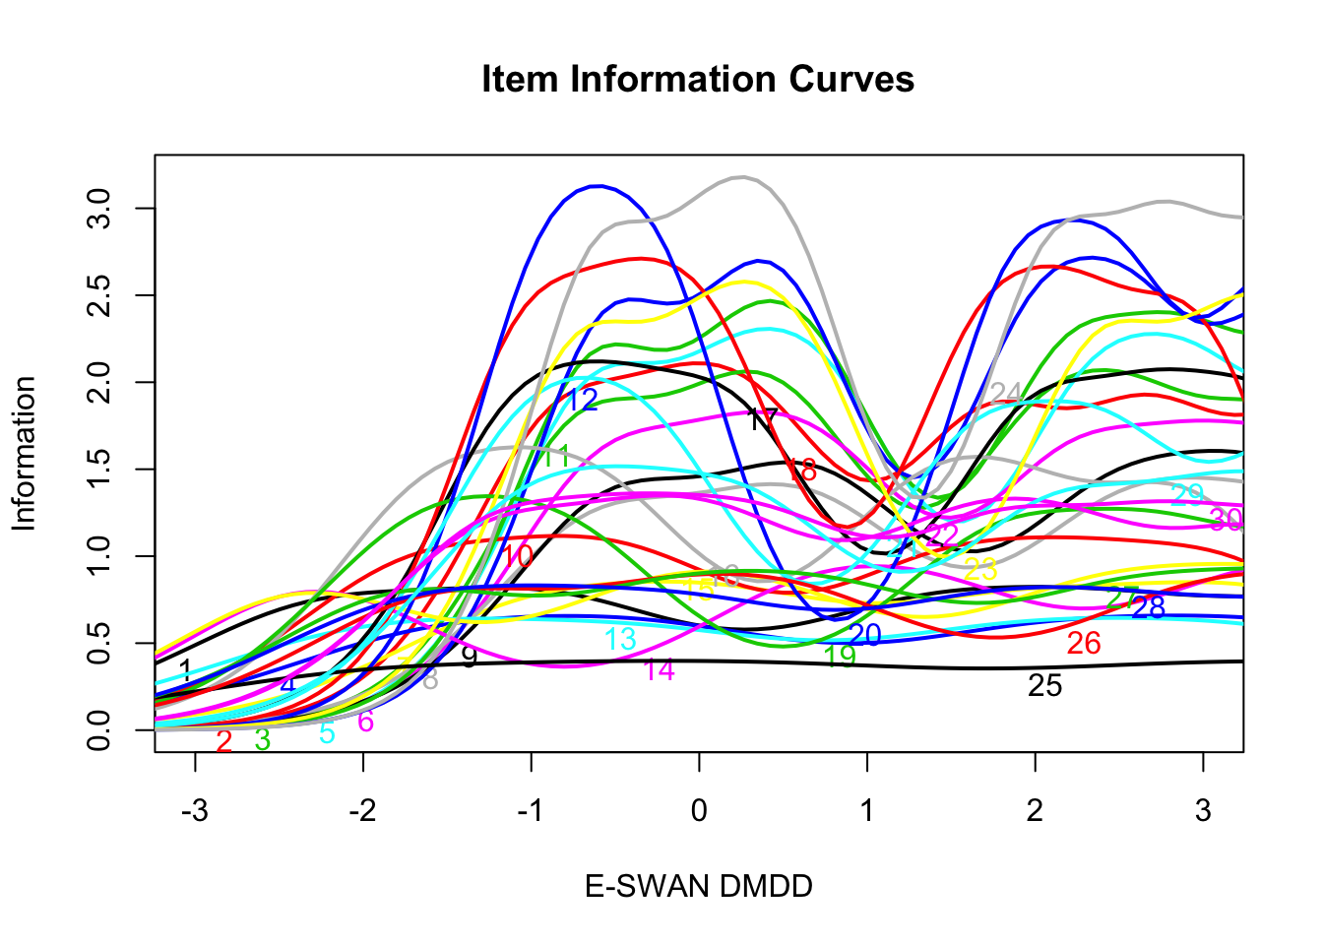
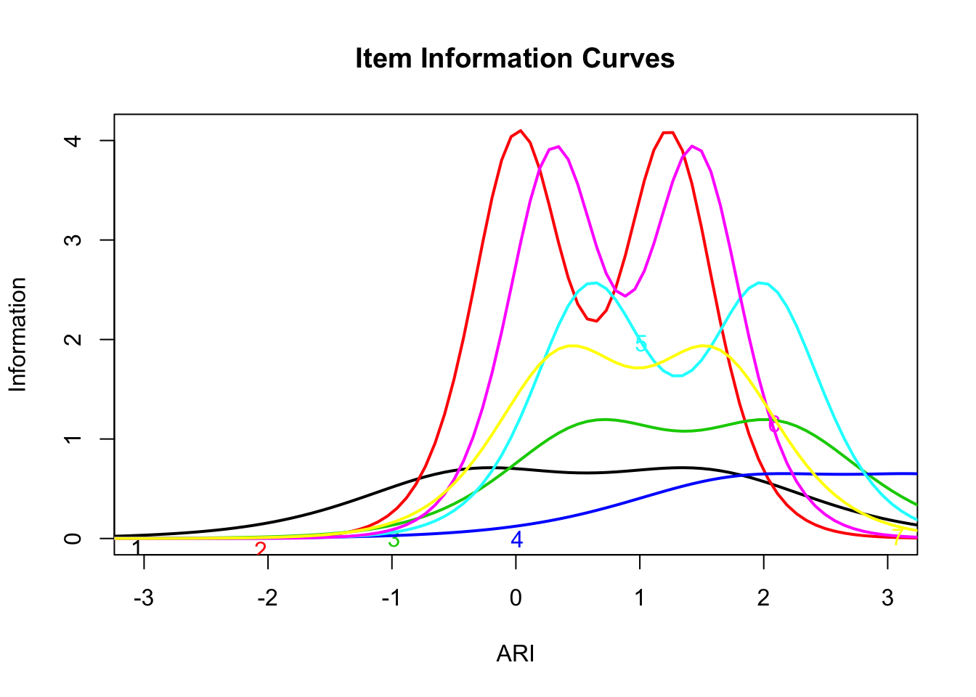
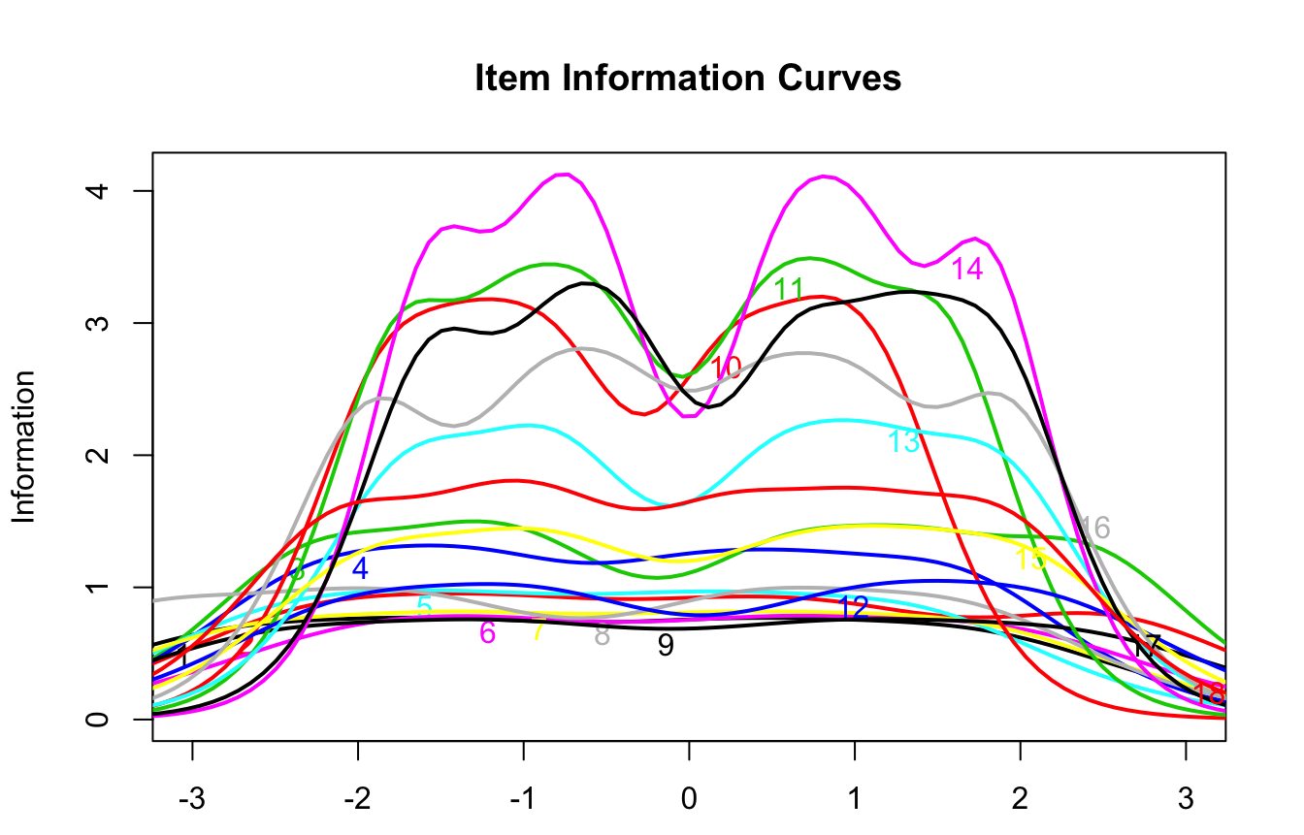
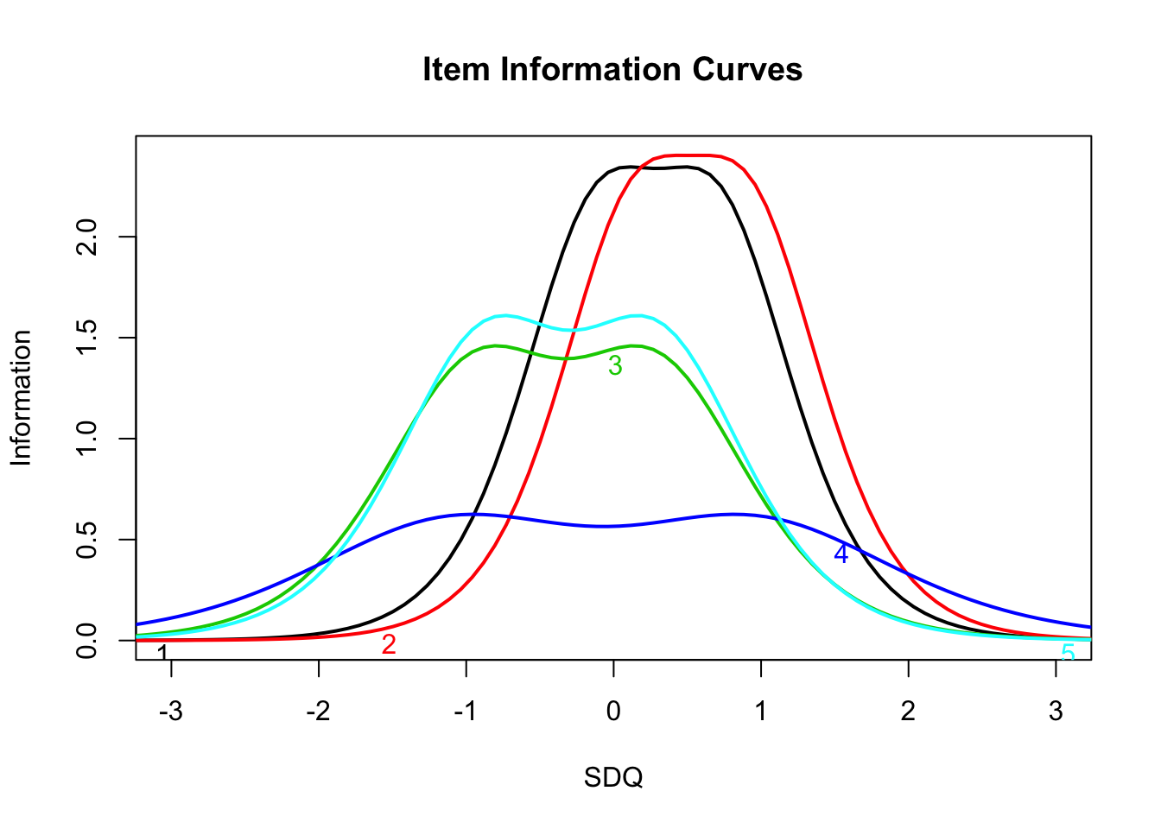
Comparison of Test Information Function
E-SWAN
Traditional Scales
Latent Trait Measured by
E-SWAN DMDD Subscale
Latent Trait Measured by
Affective Reactivity Index (ARI)
Latent Trait Measured by
E-SWAN ADHD Subscale
Latent Trait Measured by
SDQ Hyperactivity Subscale

Slide 37
Item Response Curves
Item Response Curve
Item Response Curve
Probability
Probability
Latent Trait Measured by
E-SWAN Depression Subscale Item 7
Latent Trait Measured by
Mood and Feelings Questionnaire (MFQ) Item 3

Slide 38
Item Response Theory Analysis Conclusions
All models showed good model fit and met assumption of unidimensionality needed for Item Response Theory.
When compared to unipolar scales, the E-SWAN scales show more information is being captured about the latent trait, particularly at the extreme ends.
Item response curves indicate that the response scale (far above average to far below average) used to rate E-SWAN items matches the distribution of the latent trait.
Limitations:
  Small sample size

Slide 39
Future Directions
Ongoing HBN data collection
  Increased sample size will overcome limitations of current analyses
  Neuroimaging analysis with new subscales
  Data will be openly shared so that others can conduct their own analyses
The following scales are currently under construction
  Generalized Anxiety Disorder (GAD)
  Separation Anxiety
  Bipolar Disorder
  Obsessive Compulsive Disorder (OCD)
We are inviting community involvement in the extension of the framework to additional disorders. Preliminary version of website available: www.eswan.org
  Website allows other researchers to download and use these scales in research studies
  Allows users to provide comments and feedback on methods and results, and to collaborate on the development of future scales
  More functionality to come over upcoming weeks
Capturing the Neural Correlates of Trait Differences in Attentional Regulation: The Impact of Questionnaire Design (POSTER SESSION 2; # 2.37)

Slide 40
Acknowledgements
E-SWAN Development Group
  Michael Milham
  Giovanni Salum
  James Swanson
Christian Kieling (UFRGS) for feedback on depression questions
Ellen Leibenluft and Melissa Brotman (NIMH) for feedback on DMDD questions
Thank you to the Healthy Brain Network for collecting E-SWAN data!

