Slide 1
Strengths and Weakness of ADHD-symptoms and Normal-behavior (SWAN) Rating Scales for Assessment of ADHD
James M Swanson, PhD
Professor of Pediatrics, UC Irvine

Slide 2
SWAN Created for Population-Based Studies
1980 Created the SNAP when DSM-III was released
  DSM-III items for Attention Deficit Disorder (ADD)
  Swanson, Nolan and Pelham (SNAP) scale with 4-point rating
  Developed norms during lectures to teachers (in groups)
  Used in clinical studies of medication for ADD (Swanson et al, 1983)
1994 Revised the SNAP for DSM-IV
  DSM-IV items for Attention Deficit Hyperactivity Disorder (ADHD)
  Short-form with 18 ADHD items
  Long-form with 91 items for all psychiatric disorders of childhood
  Used for clinical assessment of at the UCI Child Development Center
1999 Created the SWAN for population-based studies
  Florence Levy initiating the Australian Twin Study with David Hay
  Planned to use the SNAP rating scale
  Concerned about SNAP score distribution in a population study
  Most participants would not meet criteria for ADHD

Slide 4
Typical Rating Scale Approach (e.g., for SNAP):
Severity of “symptom presence” on 4-point scale
Example Item:
Often fails to give close attention to detail
Not at All
Just A Little
Quite a Bit
Very Much
Increasing Symptom Severity
0
Not Present
1
2
Degree Present
3
Notes:
Defining Remission In ADHD Using The DSM-IV
Remission can be standardized by a mean score of ≤1 on most scales. The majority of scales are based on the symptoms of the DSM-IV, with items being measured on a four point scale, ranging from 3, indicating a score of ‘very much’ for that symptom, to a 0, indicating ‘not at all’.
A standardized definition of remission for most scales can be defined as a mean of ≤1 (little or not at all), simply by adding up the scores for all items and and dividing by the number of items used in the particular scale; for example, on the 18 item SNAP rating scale of ADHD symptoms, dividing the total score by 18 to get the mean score, or on the Connors 10-item short-form, dividing the total score by 10 to get the mean score.

Slide 5
Swanson, Nolan, and Pelham (SNAP) Rating Scale
Often fails to give close attention to detail
0 +1 +2 +3

Slide 6
The SWAN was derived from the SNAP
SWAN
Often fails to give close attention to detail
-3 -2 -1 0 +1 +2 +3
Compared to other children, how does
& avoid
Keep track of
Ignore
Remember
Control movement of
Sit still (control squirming)
Stay seated in
Modulate motor activity (inhibit running/climbing in
Play
Settle down and rest (control constant activity)
Modulate verbal activity (control excess talking)
Reflects on
Enter
without interruptiing)

Slide 7
How does this child give close attention to detail?
+3 +2 +1 0 -1 -2 -3

Slide 8
SNAP
N = 847
mean = 0.54
sd = 0.67
skew = 1.47
SWAN
N = 656
mean = -0.13
sd = 1.46
skew = 0.01
0 1 2 3 4 5 6
6 5 4 3 2 1 0
1 2 3 4 5 6 7
7 6 5 4 3 2 1
Above Average
Average
Below Average

Slide 9
Example Studies Using the SWAN
Twin Studies
  Hay et al (2007); Polderman et al (2007)
  High DZ correlations for the SWAN (small contrast effect)
Prevalence and Norm Studies
  Swanson et al (2001); Smalley et al (2007); Arnett et al (2012)
  Shift in distribution (due to Lake Wobegon effect)
Brain Imaging Studies
  Volkow et al (2009)
  Correlation of DAT/DR2 density from PET with the SWAN
Pharmacogentic Studies
  Arcos-Burgos et al (2012)
  Enhanced range of response to medication on the SWAN

Slide 10
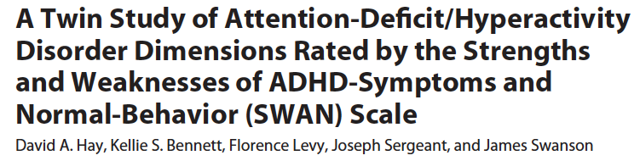
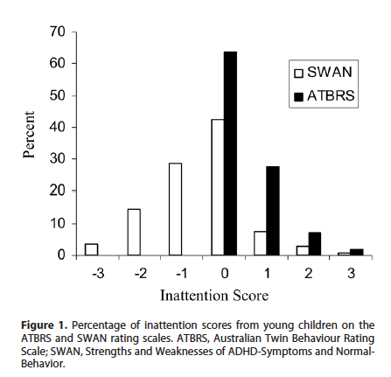
Use of the SWAN in a Twin Study

Slide 11
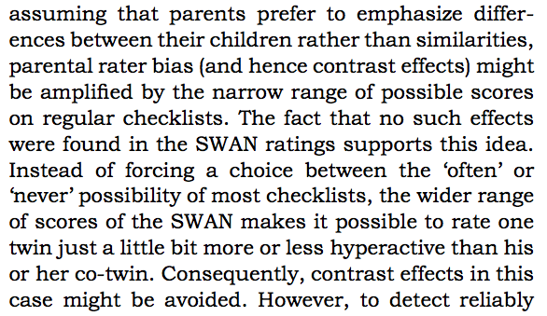
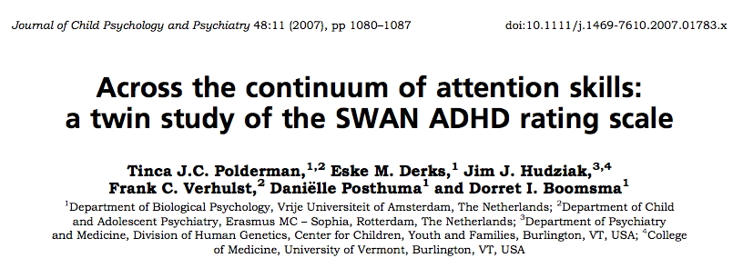

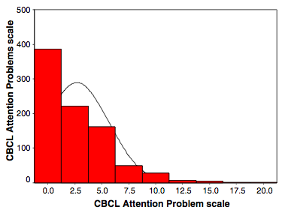
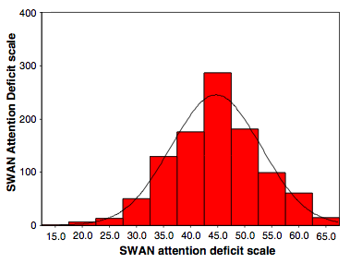
Use of the SWAN in a Twin Study

Slide 13
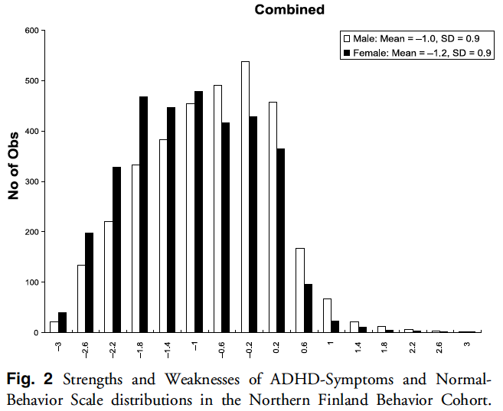
95% Percentile Cutoff
For Combined = 0.278
Above Average
Average
Below Average

Slide 14
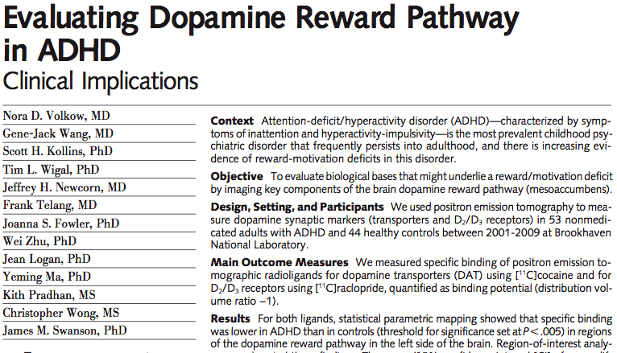
Use of the SWAN in a Brain Imaging Study
Notes:
Recent finding of a collaborative group (see Volkow et al, 2009) support the concept of “motivation deficit disorder”.
This study was based on brain imaging of adults with ADHD using positron emission tomography (PET).
We identified brain regions – the “hubs” of a dopamine motivation network well as an attention network -- that were underactive in adults with ADHD.

Slide 15
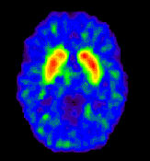
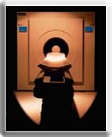
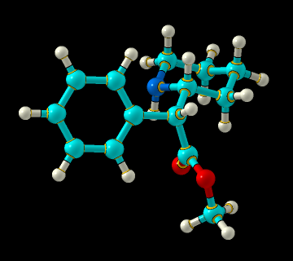
PET studies of the Site of Action of Methylphenidate in the Human Brain
¹¹C
methylphenidate
[11C]methylphenidate
Positron Emission Tomography (PET) studies show that methylphenidate acts predominantly in the striatum of the human brain where it binds to DA transporters
Notes:
PET has also been applied to investigate the site of action of methylphenidate.
The drug (MPH) has been labeled with 11C, and thi s makes it simple to track were the drug goes in the brain.
Many PET studies demonstrate that MPH binds to dopamine transporters, predominantly in the striatum of the human brain.

Slide 16
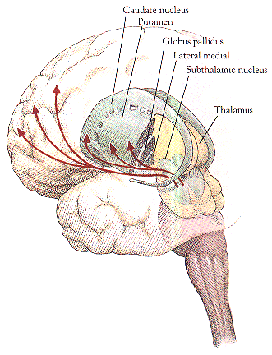
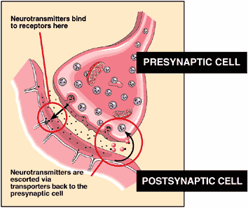
Dopamine
-
Deficit Hypothesis of ADHD/HKD
(based on stimulant drug site
-
of
-
action hypothesis)
MAO A
DA
DA
DA transporters
[11C] MPH or Cocaine
DA
DA
DA
DRD2
signal
DAT
PET Measures
DA Transporters
DA D2 Receptors
DA D2 receptors
[11C] Raclopride
Notes:
The radioligand [11C] MPH and [11C] Cocaine have been shown to label DAT.
The radioligand [11C] Raclopride has been shown to label DA D2 receptors.
Here are some PET images based on these radioligands.

Slide 17

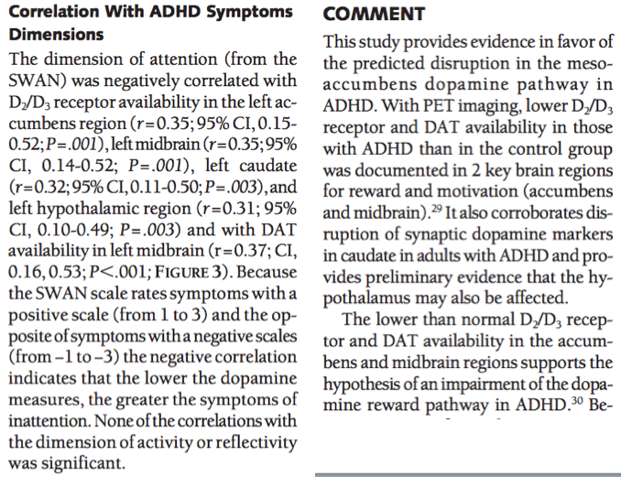
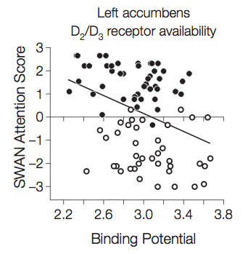
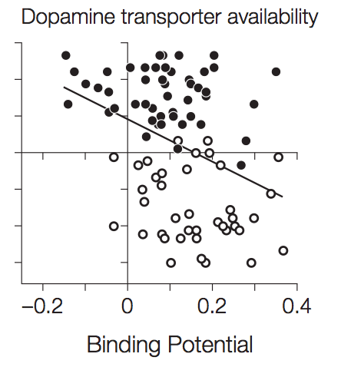

Slide 18
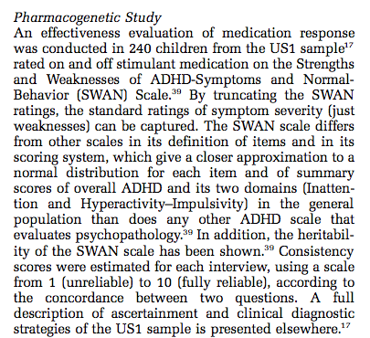
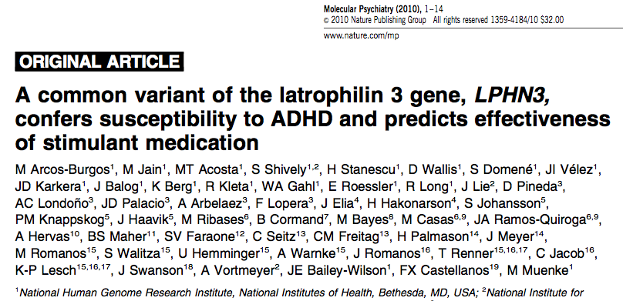
Use of the SWAN in a Genetic Study

Slide 19
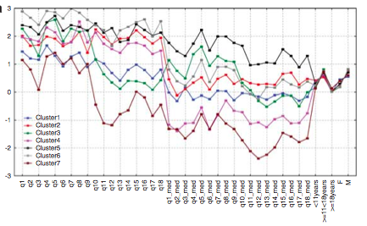
Cluster Analysis Identified Subtypes of ADHD
9 Inattentive 9 Hyper/Imp
Below Average
Below Average
Combined Type
Inattentive Type
Above Average
Above Average
Inattentive Hyper/Imp

Slide 20
SWAN Extends Range of Medication Response
Below Average
Placebo
Inattentive Hyper/Imp
Medication
Inattentive Hyper/Imp
Above Average

Slide 21
Association of LPHN3 Haplotype and Extended Response to Medication on the SWAN

Slide 22
Other Examples of Use of the SWAN:
Preschool Samples

Slide 23
Other Examples of Use of the SWAN:
Genetic and Neuropsychology

Slide 24
Other Examples of Use of the SWAN:
Subtypes and Symptom Domains

Slide 25
Other Examples of Use of the SWAN:
Both Ends of the Continuum or Dimension

Slide 26
Summary
DSM-5 content is used to define items on the SWAN
  the clinical wisdom of DSM is captured
Each symptom is dimensionalized on the SWAN
  a 7-point rating measures full range of behavior
Scores are normally distributed for the SWAN
  Not skewed as typical 4-point symptom-severity ratings
Some types of studies benefit by using the SWAN
  Effects in genetics & brain imaging studies are enhanced

